Slide 1




Kenil pansara Vaibhavi jantralwala Krishna patel Trainer : Rohit bhaduriya Tate : 11 April , 2025
Earthquake Prediction
TEAM-ID :CU_CP_Team_8364

Slide 2

Insights About our project :
What is an earthquake ?
>> An earthquake is the sudden shaking of the Earth's surface caused by the release of energy from within the Earth's crust. This energy release occurs when tectonic plates shift or when there's a sudden rupture along a fault line. The shaking can vary in intensity and can lead to serious damage to life, infrastructure, and the environment.
Why is Earthquake Prediction Important ?
>> Earthquake prediction is crucial because it can save lives, reduce economic losses, and enhance preparedness. Unlike storms or floods, earthquakes strike without warning, often within seconds. Accurate predictions can help in early evacuation, disaster planning, and emergency response, especially in high-risk areas. This makes developing prediction models a top priority in disaster management.

Slide 3
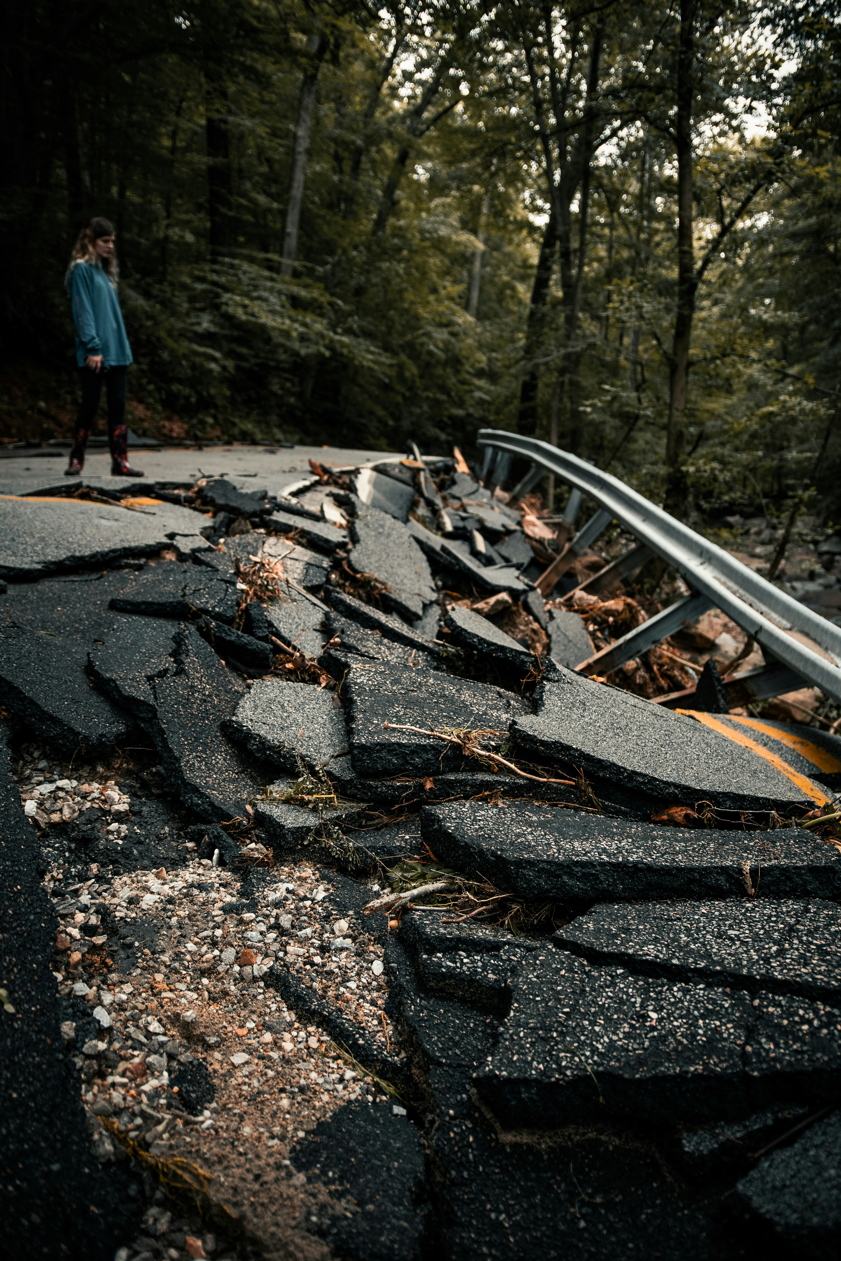
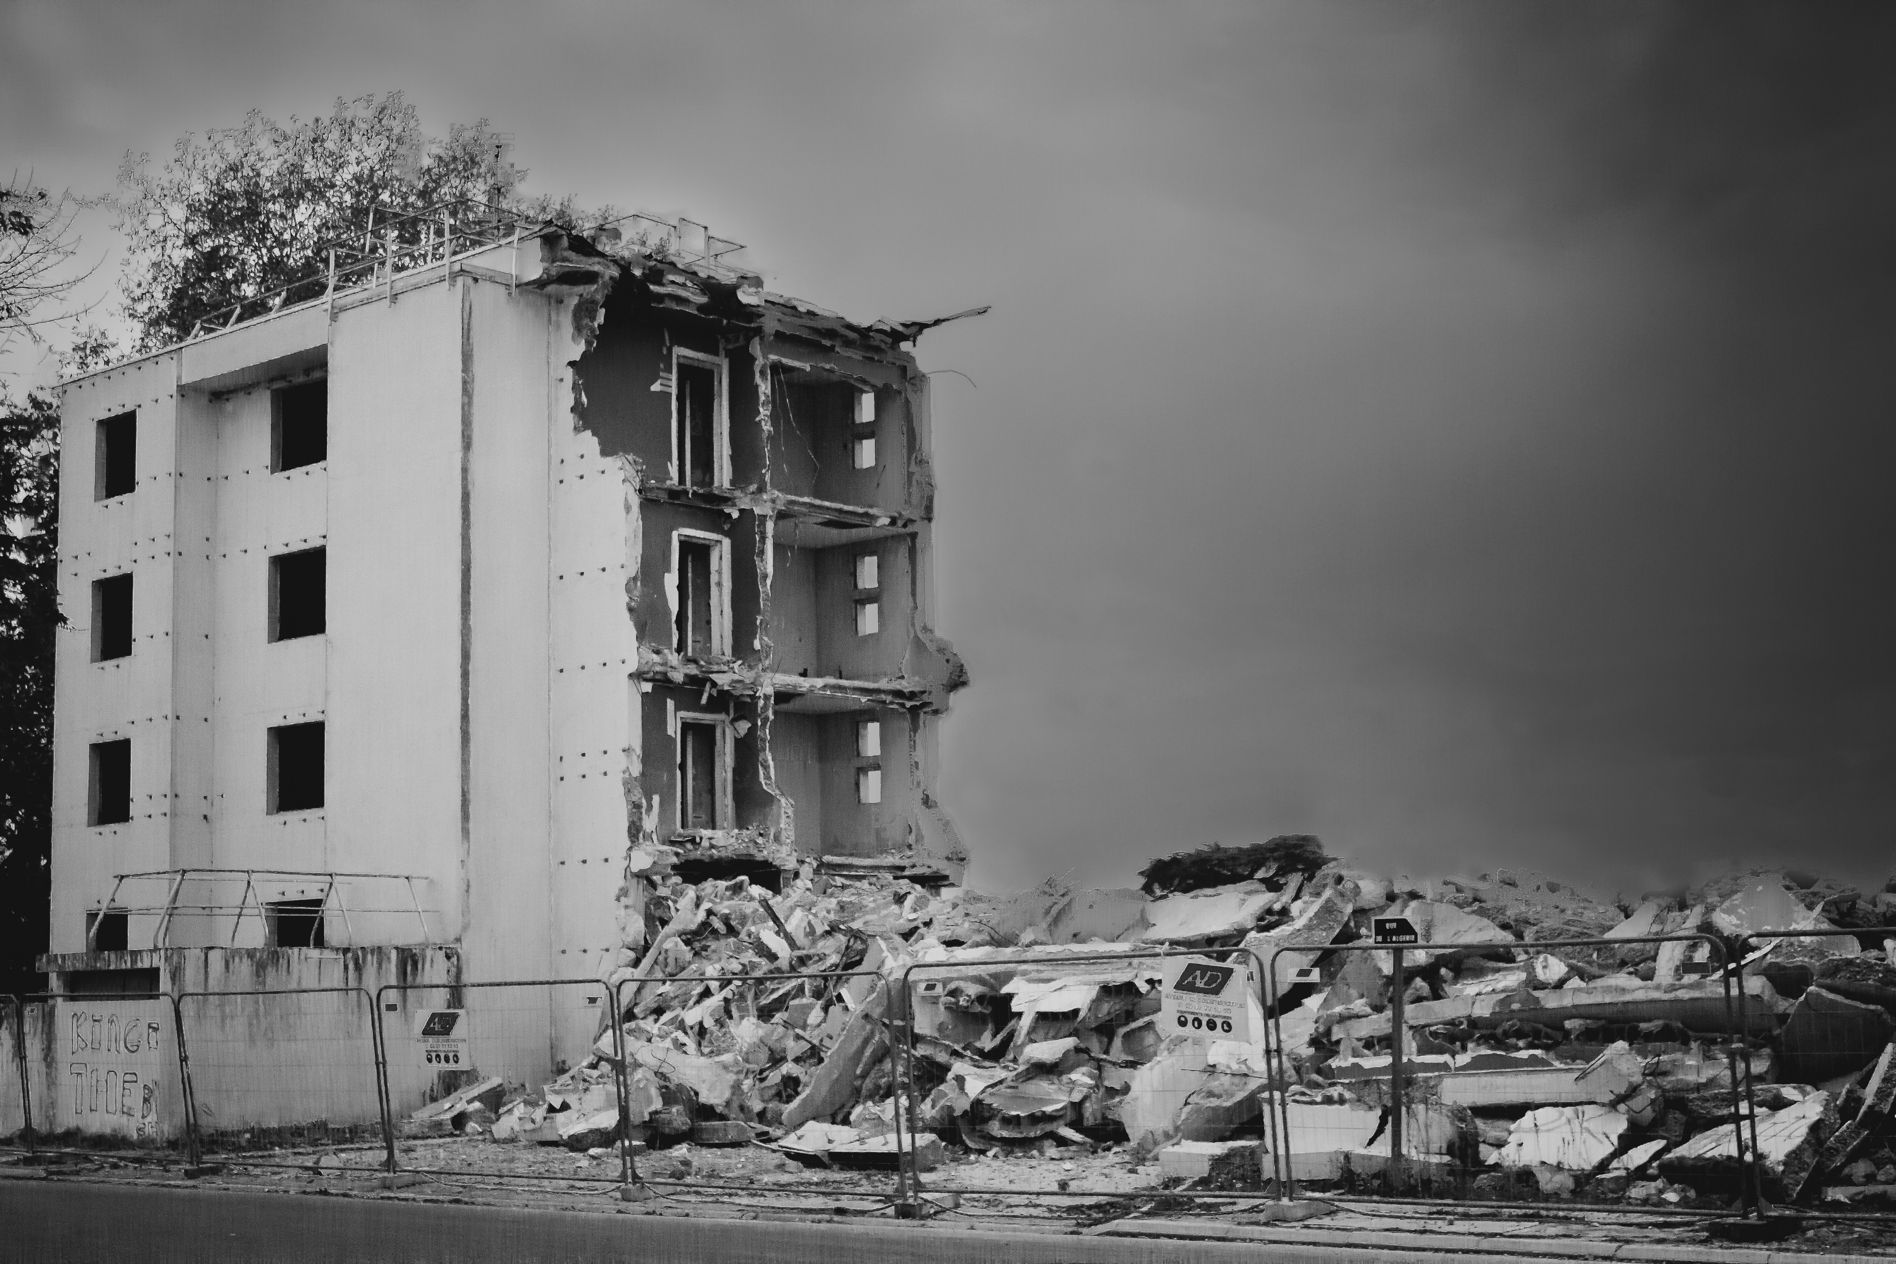
The Problem :
>> Earthquakes are sudden and devastating natural disasters that occur without warning, causing loss of life, property damage, and economic disruptions. Despite advancements in technology, accurate real-time prediction of earthquakes remains a major challenge.

Slide 4
Challenges in Earthquake Prediction :
- Lack of labeled data for past earthquakes. - Complex and non-linear patterns in seismic activity. - Difficulty in identifying the exact time, location, and magnitude. - High risk of false positives or false negatives. - Seismic signals are often buried in noise and hard to interpret.
Objective Of Project:
- The goal is to develop a machine learning model that can analyze historical seismic data and identify patterns that may indicate an upcoming earthquake. The objective is not to predict the exact time but to increase the chances of early warnings, helping reduce the impact on human life and infrastructure.

Slide 5
Dataset Source > KAGGLE Features in dataset :
These are the key features (columns) selected for prediction:
Magnitude – Measures the energy released during the earthquake.
Depth – How deep the earthquake originated beneath the surface.
CDI (Community Internet Intensity) – Reflects human-reported shaking experiences.
MMI (Modified Mercalli Intensity) – Instrumental estimate of ground shaking.
SIG (Significance) – A computed value reflecting the overall impact.
Target Variable
Alert – A warning level based on severity and impact.
Categories like: green, yellow, orange, red (severity levels)

Slide 6
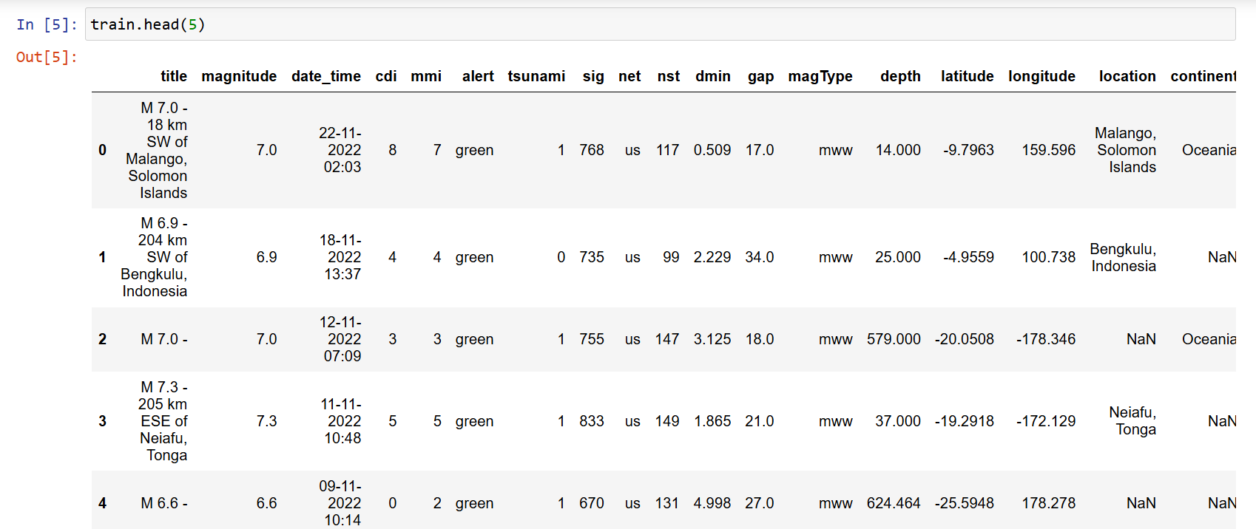
DATASET

Slide 7
Preprocessing Steps :
1. Handling Missing Values
Methods Used:
Imputation: Filling missing data with mean/median/mode values.
Deletion: Removing rows or columns with missing data.
Advanced Techniques: Using models like KNN or regression to predict missing values.
Why Important?: Missing values can distort analysis and predictions.
2. Feature Selection/Scaling
Feature Selection:
Correlation Matrix: Dropping highly correlated features.
Statistical Tests: Using techniques like Chi-square to identify important features.
Feature Scaling:
Standardization: Converting features to zero mean, unit variance (e.g., Z-score).
Normalization: Rescaling features between a specific range (e.g., 0-1).
3. Data Cleaning
Outlier Detection & Removal: Using statistical methods (e.g., IQR or Z-scores) to identify and remove outliers.
Duplicate Removal: Identifying and removing duplicate rows to ensure data integrity.
Text Preprocessing (if applicable): For NLP tasks, removing stop words, stemming, and lemmatization.
Data Type Conversion: Ensuring all columns have the correct data types for analysis.

Slide 8
Machine Learning Algorithm Used :
Algorithm Chosen: Random Forest
Why Random Forest?
Accuracy: Random Forest is great for handling complex datasets with multiple features and gives good results without much tuning.
Interpretability: Though it’s an ensemble method, it’s still relatively interpretable compared to some black-box models like deep learning.
Handles Missing Data: Random Forest is great at dealing with missing data and doesn’t require scaling of features.
Robust to Overfitting: Even with noisy or unbalanced data, it’s less prone to overfitting compared to many other models.
Fast Training: With enough trees, it can still train quickly, especially for earthquake prediction where data isn’t too large.
Why This Algorithm ?
Nature of Data: Earthquake prediction typically involves many variables (like geological data, seismic activity, etc.). Random Forest handles multiple features well and can capture complex relationships between them.
Classification Task: Earthquakes are often predicted as "Yes" or "No" based on various indicators — so a classification model like Random Forest fits perfectly.
Prediction Efficiency: It can predict earthquake likelihood based on historical seismic data and geographical features.

Slide 9
Flow of the Algorithm :
Step 1: Data Collection — Gathering historical earthquake data (seismic activity, fault lines, etc.).
Step 2: Preprocessing — Cleaning, handling missing values, feature selection.
Step 3: Model Training — Using the training data to build the Random Forest model.
Step 4: Prediction — Predicting the likelihood of earthquakes based on new data.
You can include a simple decision tree diagram here to show how Random Forest works (since it’s an ensemble of decision trees).
If you want an easier model for this, you can go with Logistic Regression. It’s simpler but might not be as accurate for this problem, especially if the relationships in the data are complex.

Slide 10
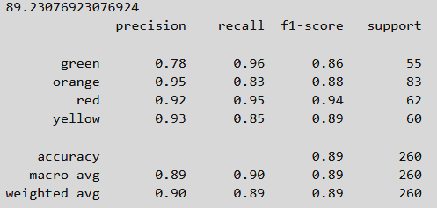
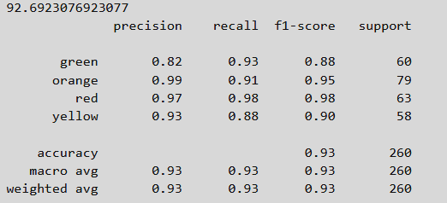
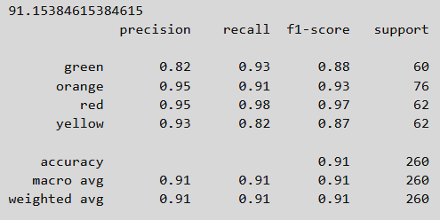
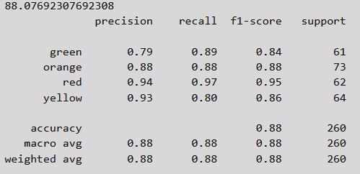
Accuracy of the model
Decision Tree Classifier has an accuracy of 88.07%.
KNN has an accuracy of 89.23%.
Random Forest Classifier has an accuracy of 91.15%.
Gradient Boosting Algorithm has an accuracy of 92.69%.
I
IV
III
II

Slide 11
Conclusion :
We are pleased with the current performance, we recognize that there is always scope for improvement. Each team member has contributed their best efforts, and we believe that with more data and advanced techniques, the model can be refined further. We are committed to enhancing its accuracy and look forward to the opportunity to continue improving the model together in the future.

Slide 12
Thank you...!
Notes:
12

